Slide 1

FIT A STRAIGHT LINE
Dinesh Babu J

Slide 2
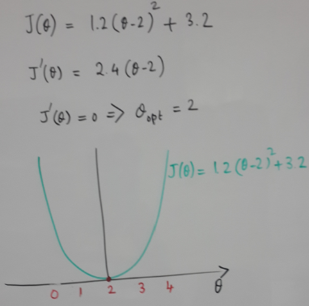
FN MINIMIZATION
Exercise
CLOSED FORM

Slide 3
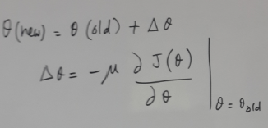
Iterative method
$$θ(new)=θ(old)-μJ^{{}^{′}}(θ)$$
GRADIENT DESCENT

Slide 4
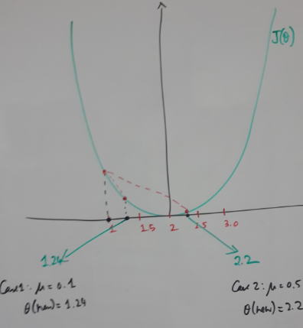
Cost function
Gradient of the cost function
$$J(θ)=1.2(θ-2)^{2}+3.2$$
$$J^{{}^{′}}(θ)=2.4*(θ-2)$$
$$θ(new)=θ(old)-μJ^{{}^{′}}(θ)$$
at
$$θ=θ(old)$$
Gradient Descent
$$θ(new)=θ(old)-μ*2.4(θ-2)$$
at
$$θ=θ(old)$$
$$θ(old)=1$$
$$θ(new)=1-μ*2.4(1-2)$$
$$Case1:μ=0.1$$
$$θ(new)=1-0.1*2.4(1-2)=1.24$$
$$Case2:μ=0.5$$
$$θ(new)=1-0.5*2.4(1-2)=2.2$$

Slide 5
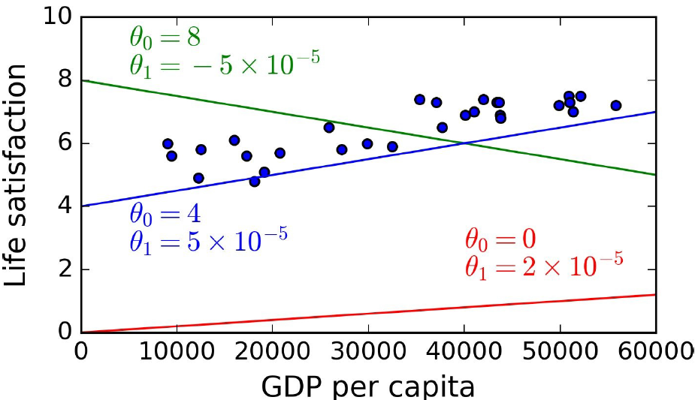
Example problem
Optimisation: Shopping in the model space
b
a
a
b
$$Model:ypred=a+b*x$$
b
a
a
b
a
b
b
a

Slide 6
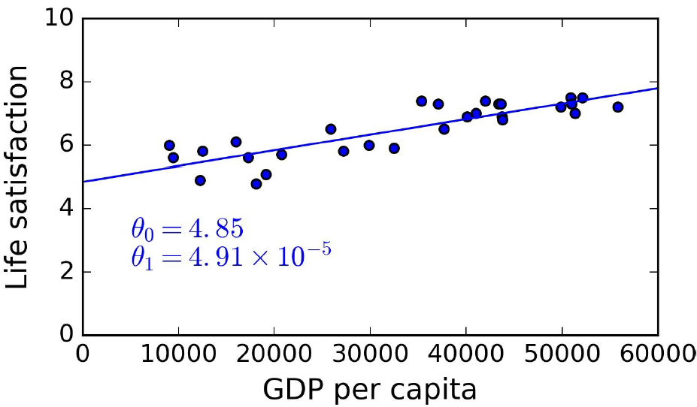
Example problem
a
b

Slide 7
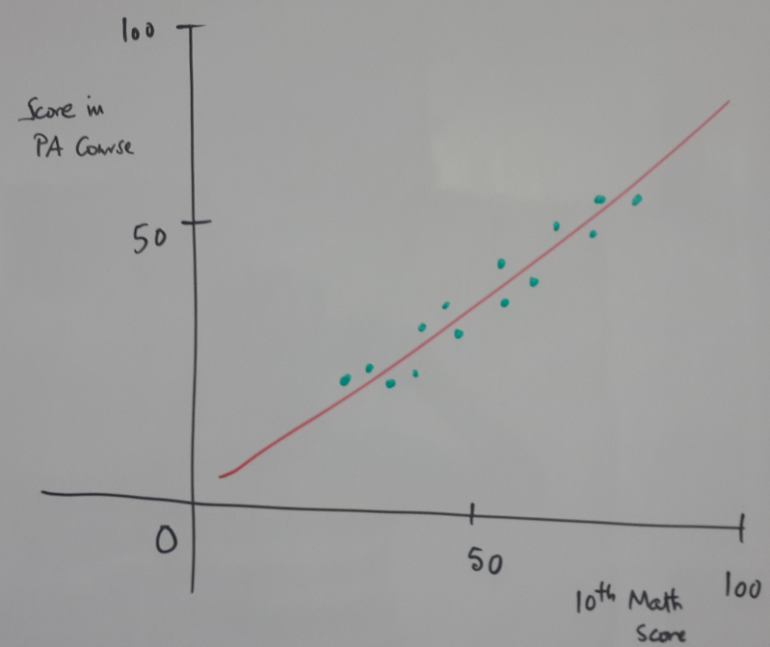
Fitting a straight line
Score
In ML course
$$Data:\{x_{i},y_{i}\}_{i=1:N}$$
$$Model:ypred=a+b*x$$
$$Loss:J(a,b)=∑(y_{i}-ypred_{i})^{2}$$
10th math
course

Slide 8
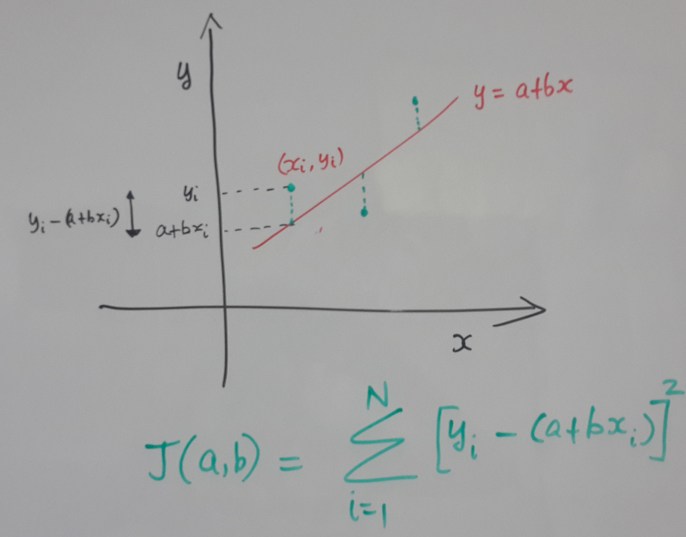
Fitting a straight line – Cost function

Slide 9
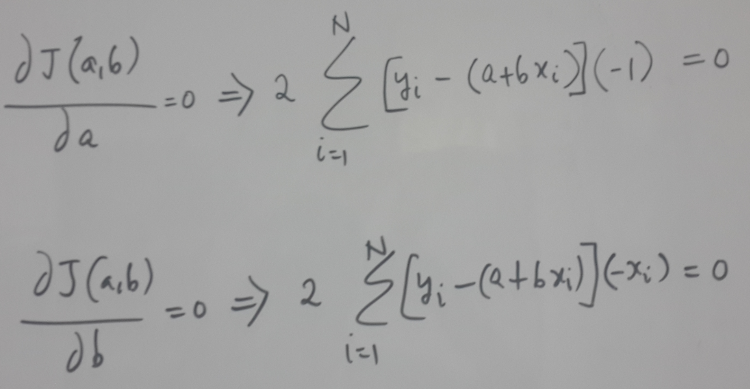
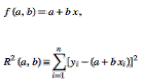
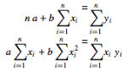
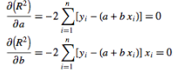
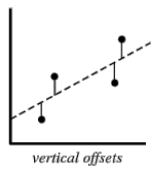
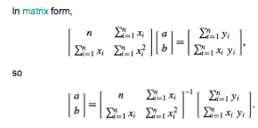
Closed form – Minimize sum of square error

Slide 10
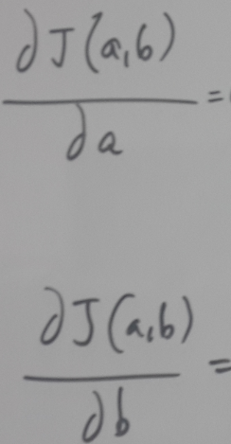
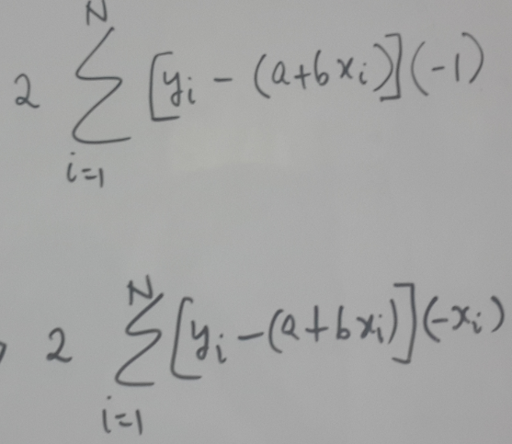
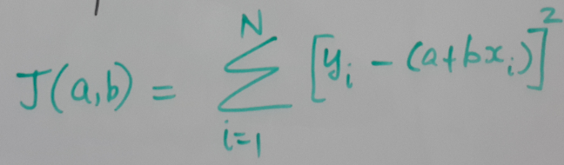
Gradient Descent – Minimize sum of square error
Notes:
Here again we compute the gradient. Then update
b as follows:
a as follows:
mu is parameter that needs to be chosen at the beginning
of our procedure.

Slide 11
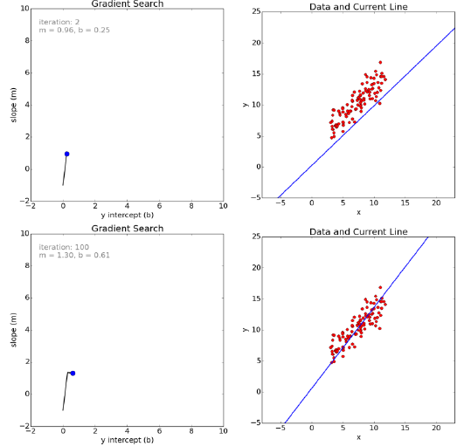
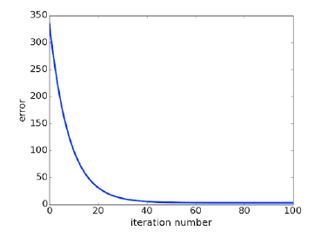
Slope
Score
In ML course
Convergence: loss function
10th math
course
Intercept
Slope
Intercept

Slide 12
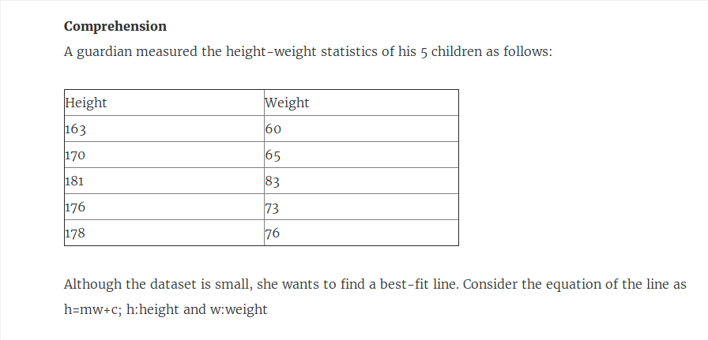
Sample problem

Slide 13
Week 1
Introduction to ML
Supervised, Unsupervised ML
Classification, Regression, Clustering
ML terminology - tasks, inference algorithm, learning algorithm, model, loss function
Fitting a straight line
Gradient descent

Slide 14
Reading
B1 Ch1, 2, 3
B1: The 100 page Machine Learning Book - Andriy Burkov [QUICK SUMMARY - FIRST READING]

Slide 15
TA session 1,2
Paper and pencil
1D cost function to minimise - closed form, gradient descent
2D cost function to minimise - closed form, gradient descent
Code
Code gradient descent (1D, 2D)
Fit a straight line - closed form answer
Fit a straight line - gradient descent, visualise data space and model space for intermediate results

Slide 16
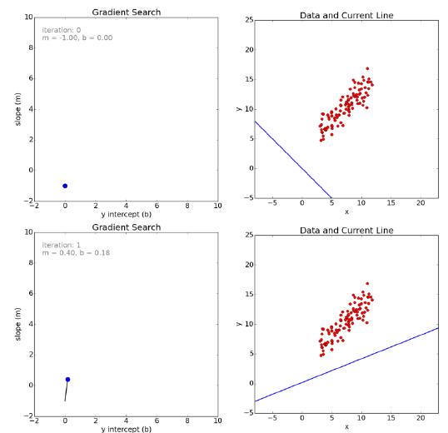
MODEL
SPACE
DATA
SPACE
b
m
$$Data:\{x_{i},y_{i}\}_{i=1:N}$$
$$Model:ypred_{i}=mx_{i}+b$$
$$Loss:L(m,b)=∑(y_{i}-ypred_{i})^{2}$$
Notes:
After several iterations, we can see that we reach the minima,
and the corresponding model parameters fit the given the data
points the best.

Slide 17
MODEL
SPACE
DATA
SPACE
b
m
m

Slide 18
News item grouping problem
TASK, DATASET, FEATURES
Predictive Clustering task:
Assign one of {1, 2, ….K} to a news article
Dataset – set of news articles
Query Google with “news”
Features – {x₁, x₂, x₃, x₄} e.g. {topic distributions}
Features from
collection of
news items
Learning
Algorithm
Cluster IDs for
every news item
Model
New article
features
Inference
Algorithm
Which Cluster
Is best suited?
Notes:
News item grouping problem is a predictive clustering task
Where we want to group news articles into semantically
Meaningful categories let us say K categories..
To get started we need a dataset which is a collection of news articles,
Say we query Google with news
From this if we obtain features that capture the topic distributions
(say percentage of sports, education etc), then
our learning algorithm can cluster these news items according to the
Topics. Given a new article we can assign the best suited cluster.

Slide 19
Solution 3: Clustering problem
MODEL, LEARNING, INFERENCE ALGORITHM
e.g. News grouping problem
Model: distance based
Collection of
news items
Cluster IDs for
every news item
Learning
Algorithm
x₂
x₂
x₁
x₁
Notes:
For the clustering problem, let us look at a distance based model..
Where we choose cluster centers, and then assign the cluster
Label based on distance from the cluster centers
Note in this case the circles were not colored to begin with
Unlike the classification problem. In this context the learning
Algorithm is unsupervised…

